Slide 1
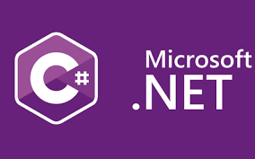
What is .Net??
.NET framework was initiated by Microsoft in the end of 1990s
.Dot net is a frame work
It’s a new programming methodology
Dot net is platform independent
Dot net language is insensitive

Slide 2
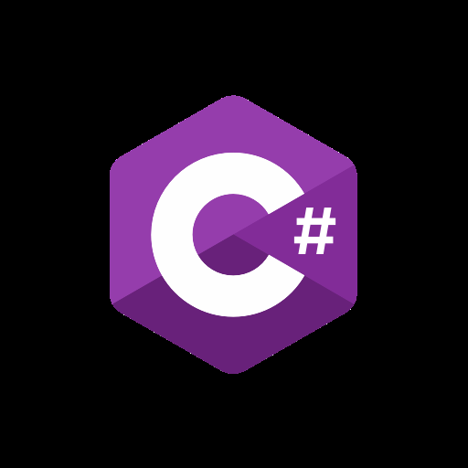
C #
C# (pronounced "See Sharp") is a modern, object-oriented, and type-safe programming language. C# enables developers to build many types of secure and robust applications that run in . NET. C# has its roots in the C family of languages and will be immediately familiar to C, C++, Java, and JavaScript programmers.

Slide 3
Versions of .net
Installers and binaries: 6.0.2 | 5.0.14
Release notes: 6.0.2 | 5.0.14
Container images
Linux packages: 6.0.2 | 5.0.14
Release feedback/issue
Known issues: 6.0 | 5.0
Improvements
ASP.NET Core: 6.0.2
EF Core: 6.0.2
Runtime: 6.0.2
Winforms: 6.0.2

Slide 4
.net-What is it?
It is an Software platform
Language Neutral
In other words:- .net is not a language(it is a runtime and alibrary for writing and executing written programs in any complaint language)

Slide 5
What .net provides??
Integrated environment
Internet,desktop,mobile devices
Consistent to object-oriented
To provide a portable environment
A managed environment

Slide 6
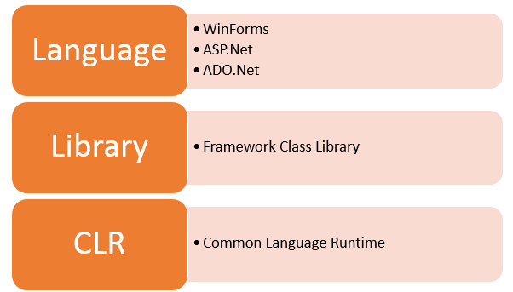
Basic Architecture of .net

Slide 7
2. Class Library
The .NET Framework includes a set of standard class libraries. A class library is a collection of methods and functions that can be used for the core purpose.
For example, there is a class library with methods to handle all file-level operations. So there is a method which can be used to read the text from a file. Similarly, there is a method to write text to a file.
Most of the methods are split into either the System.* or Microsoft.* namespaces. (The asterisk * just means a reference to all of the methods that fall under the System or Microsoft namespace)

Slide 8
.net components
The architecture of .Net framework is based on the following key components:
1.Common language runtime:
The “Common Language Infrastructure” or CLI is a platform in .Net architecture on which the .Net programs are executed.
The CLI has the following key features:
Exception Handling
Garbage Collection

Slide 9
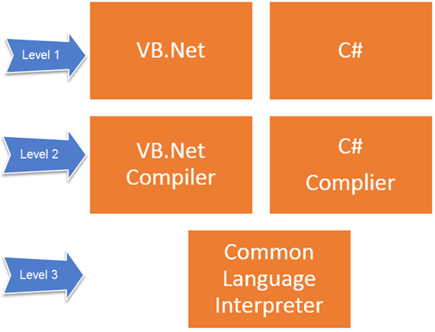
Working with Various programming languages
A developer can develop an application in a variety of .Net programming languages.
Language – The first level is the programming language itself, the most common ones are VB.Net and C#.
Compiler – There is a compiler which will be separate for each programming language. So underlying the VB.Net language, there will be a separate VB.Net compiler. Similarly, for C#, you will have another compiler.
Common Language Interpreter – This is the final layer in .Net which would be used to run a .net program developed in any programming language. So the subsequent compiler will send the program to the CLI layer to run the .Net application.

Slide 10
3. Languages:- .Net framework is classified broadly into the following categories.
WinForms – This is used for developing Forms-based applications, which would run on an end user machine. Notepad is an example of a client-based application.
ASP.Net – This is used for developing web-based applications, which are made to run on any browser such as Internet Explorer, Chrome or Firefox.
The Web application would be processed on a server, which would have Internet Information Services Installed.
Internet Information Services or IIS is a Microsoft component which is used to execute an Asp.Net application.
The result of the execution is then sent to the client machines, and the output is shown in the browser.
ADO.Net – This technology is used to develop applications to interact with Databases such as Oracle or Microsoft SQL Server.

Slide 11
.Net Framework Design Principle
Interoperability
Portability
Security
Memory management
Simplified deployement

Slide 12
Interoperability
Interoperability enables you to preserve and take advantage of existing investments in unmanaged code. Code that runs under the control of the common language runtime (CLR) is called managed code, and code that runs outside the CLR is called unmanaged code. COM, COM+, C++ components, ActiveX components, and Microsoft Windows API are examples of unmanaged code.

Slide 13
Portability
The .NET Portability Analyzer is a tool that analyzes assemblies and provides a detailed report on .NET APIs that are missing for the applications or libraries to be portable on your specified targeted .NET platforms. The Portability Analyzer is offered as a Visual Studio Extensions, which analyzes one assembly per project, and as an ApiPort console app, which analyzes assemblies by specified files or directory.

Slide 14

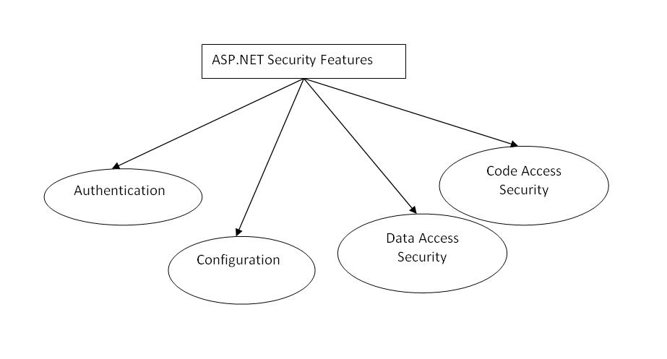
Security

Slide 15
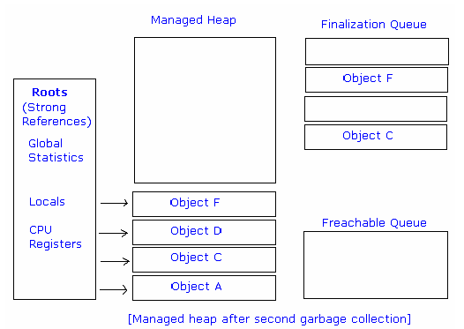
Memory management
Garbage Collector (GC) is the part of the . NET framework that allocates and releases memory for your . NET applications. When a new process is started, the runtime reserves a region of address space for the process called the managed heap

Slide 16
Simplified deployement
NET Framework provides a number of basic features that make it easier to deploy your applications: No-impact applications. This feature provides application isolation and eliminates DLL conflicts. By default, components do not affect other applications

Slide 17
Summary
.Net is a programming language developed by Microsoft. It was designed to build applications which could run on the Windows platform.
The .Net programming language can be used to develop Forms based applications, Web based applications, and Web services.
Developers can choose from a variety of programming languages available on the Microsoft .Net framework platform. The most common ones are VB.Net and C#.

Slide 18

THANK YOU

